Slide 1
LOGIC CIRCUITS

Slide 2
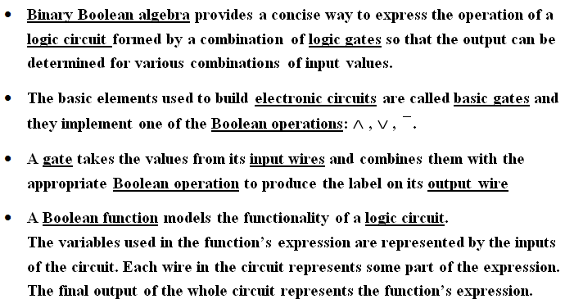
LOGIC CIRCUITS

Slide 3
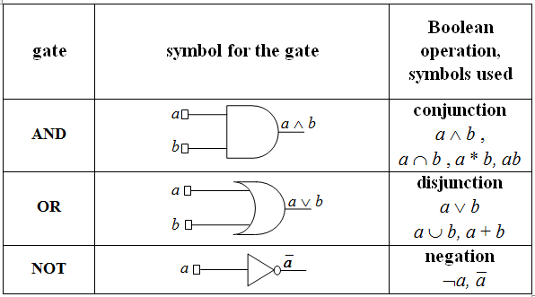
BASIC GATES – IEEE STANDARDS

Slide 4
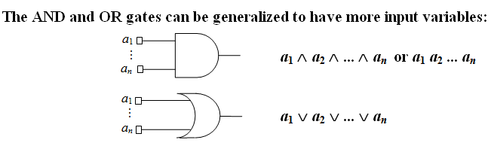
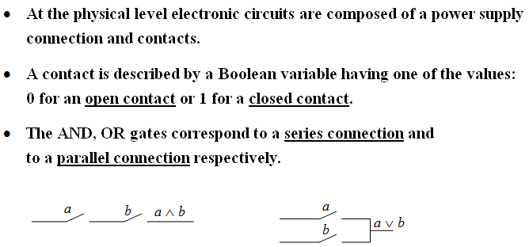

Slide 5
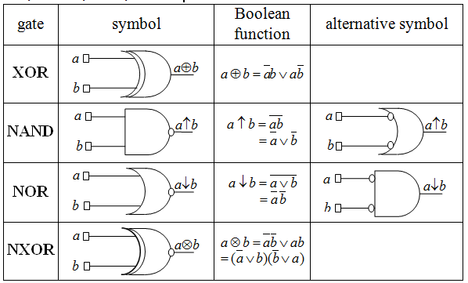
DERIVED GATES: XOR, NAND, NOR, NXOR

Slide 6
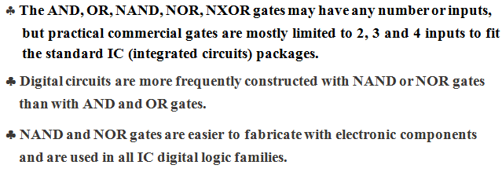

Slide 7
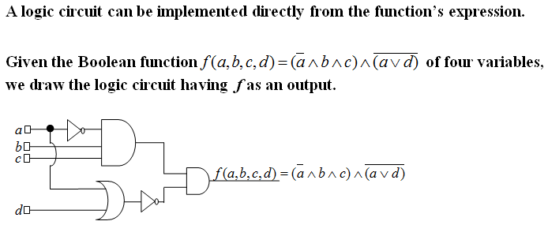
EXAMPLE 1

Slide 8
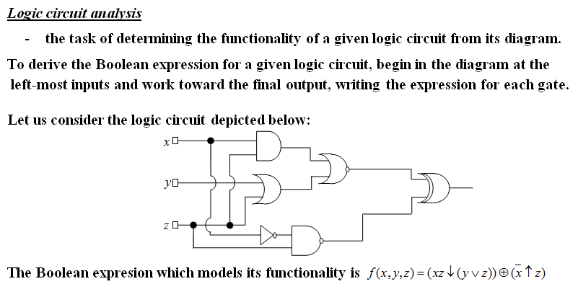
EXAMPLE 2

Slide 9
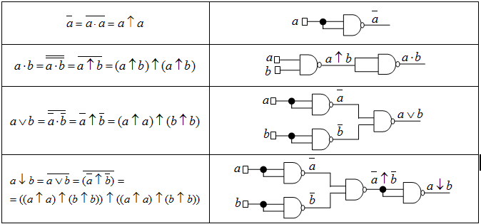
EXAMPLE 3. NAND IS A UNIVERSAL GATE
-IT CAN BE USED TO PRODUCE ALL THE OTHER GATES

Slide 10
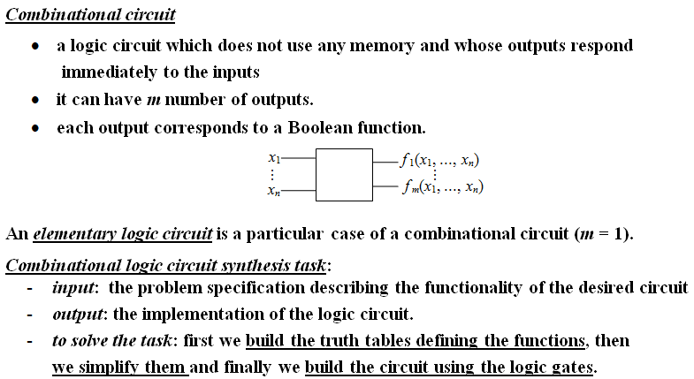
COMBINATIONAL CIRCUITS

Slide 11
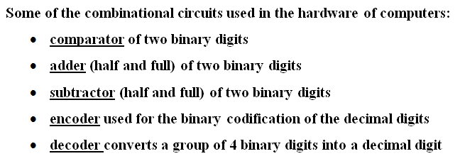
EXAMPLES OF USEFUL COMBINATIONAL CIRCUITS

Slide 12
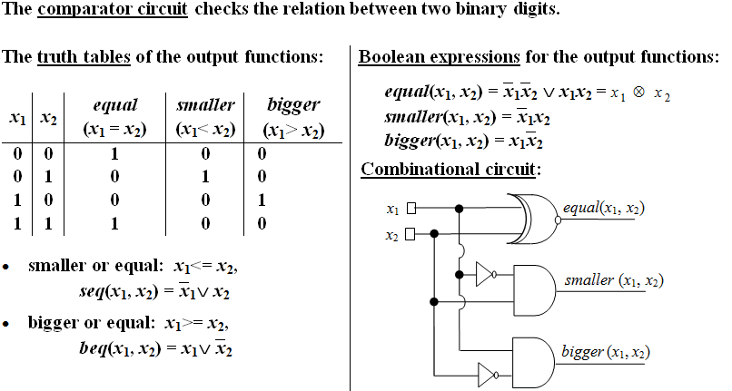
EXAMPLE 4

Slide 13
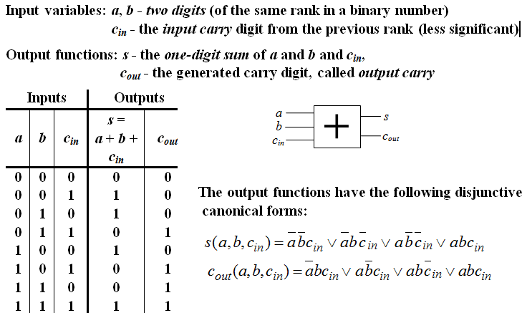
EXAMPLE 5. FULL ADDER

Slide 14
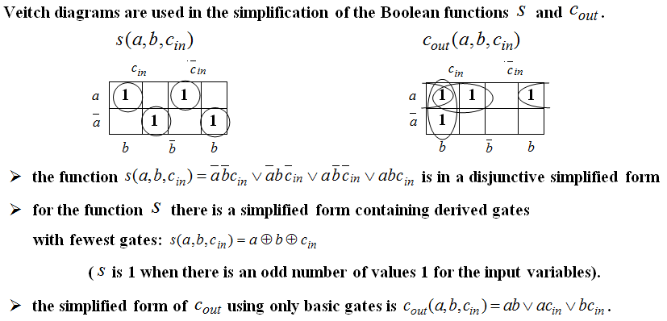
EXAMPLE 5. FULL ADDER (CONTD.)

Slide 15
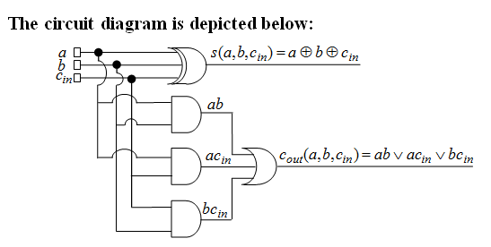
EXAMPLE 5. FULL ADDER (CONTD.)

Slide 16

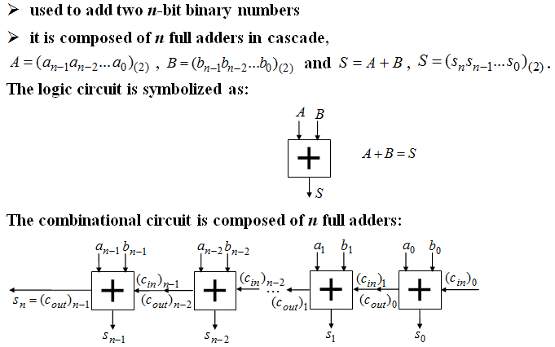

Slide 17

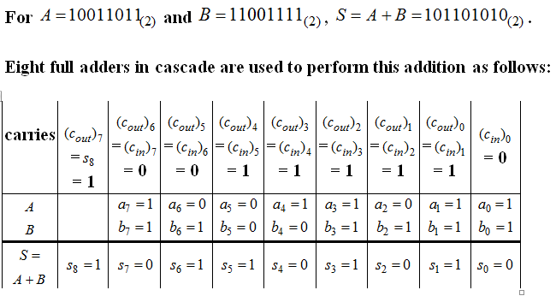

Slide 18
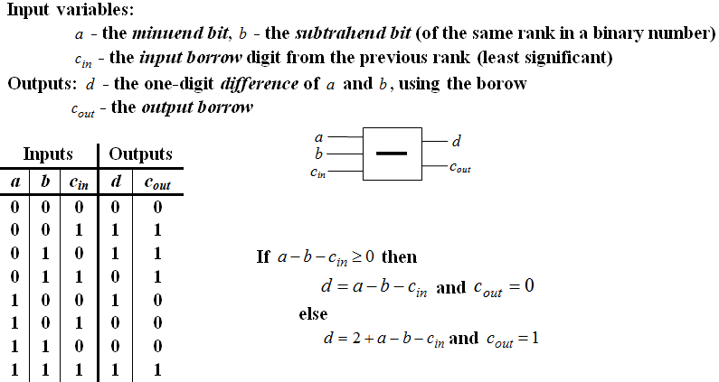
EXAMPLE 7. FULL SUBTRACTOR

Slide 19
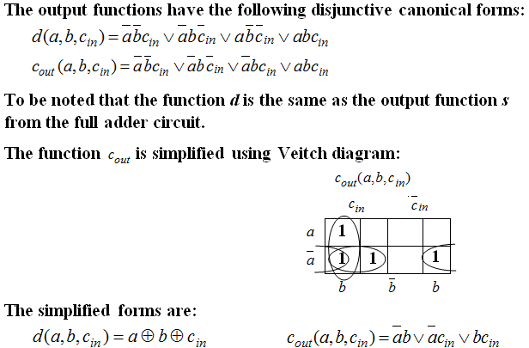
EXAMPLE 7. FULL SUBTRACTOR (CONTD.)

Slide 20
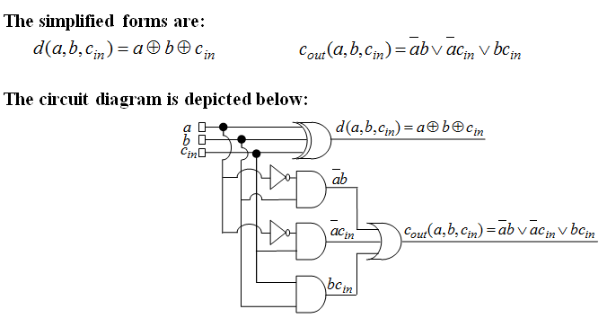
EXAMPLE 7. FULL SUBTRACTOR (CONTD.)

Slide 21

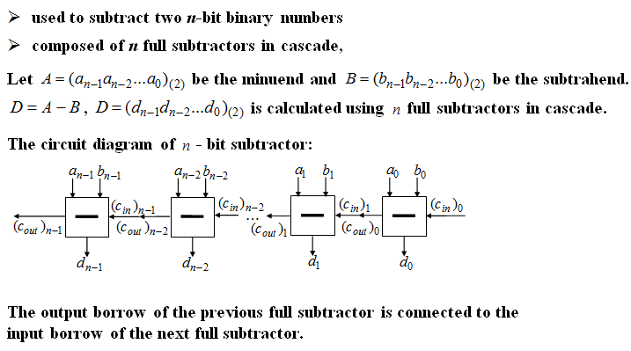

Slide 22

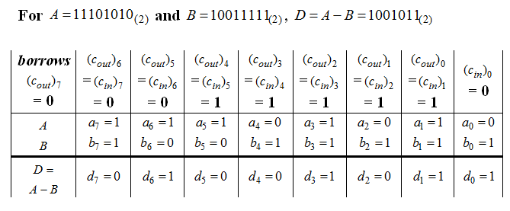

Slide 23
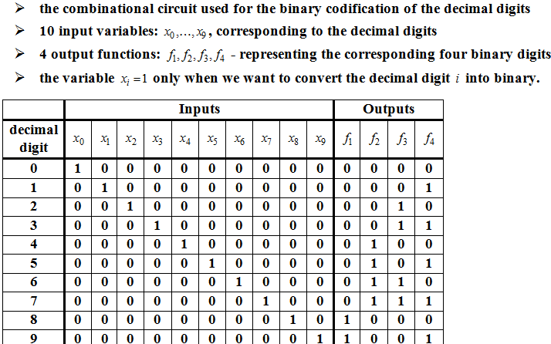
EXAMPLE 9. ENCODER

Slide 24
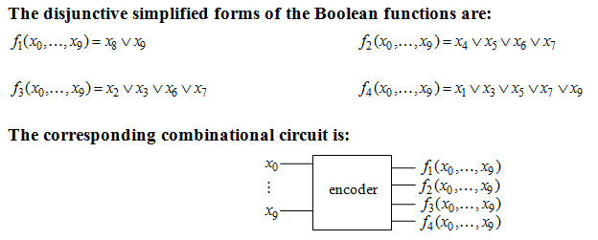
EXAMPLE 9. ENCODER (CONTD.)

Slide 25
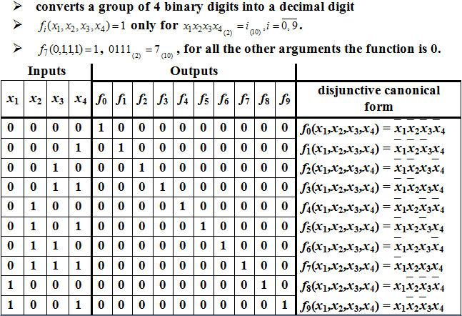
EXAMPLE 10. DECODER

Slide 26
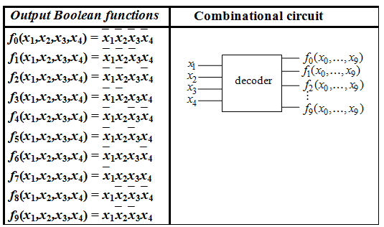
EXAMPLE 10. DECODER (CONTD.)

Slide 27
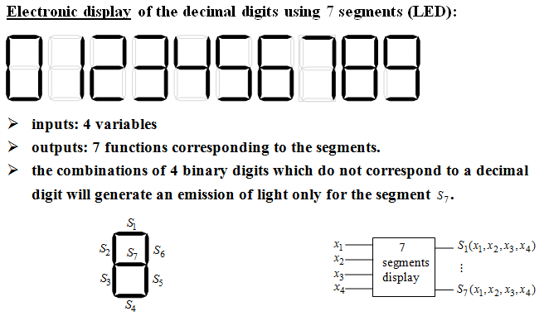
EXAMPLE 11. 7 SEGMENTS CIRCUIT

Slide 28
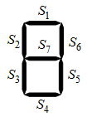
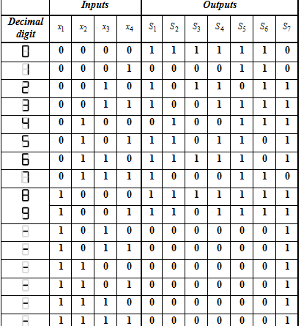
EXAMPLE 11. 7 SEGMENTS CIRCUIT

Slide 29
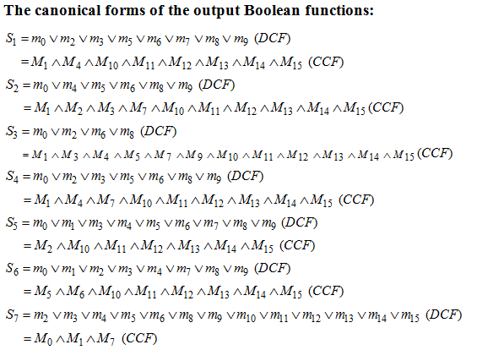
EXAMPLE 11. 7 SEGMENTS CIRCUIT (CONTD.)

Slide 30
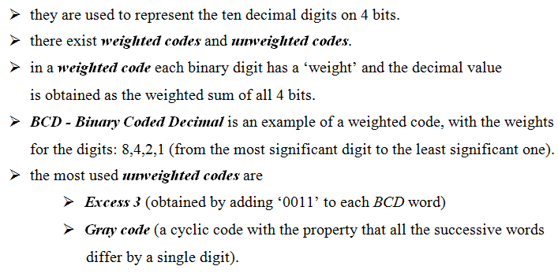
BINARY CODES

Slide 31
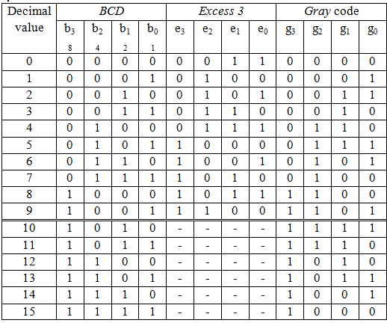
BINARY CODES (CONTD.)

Slide 32
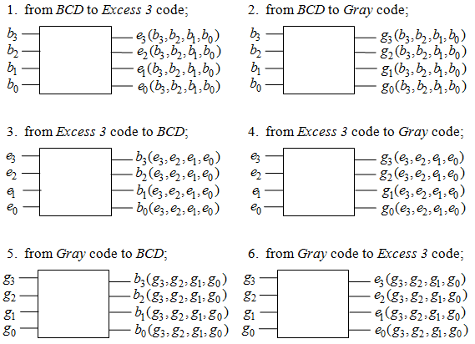
EXAMPLE 12.

